Slide 1
Antognazza | Bruxelles | 12 April 2021
Mercury Regulation
Reporting Deadline and use of the ERT
Federico Antognazza
European Environment Agency
HSR2 - Sustainable Resource Use and Industry
Industry and air pollution data flow handling

Slide 2
Mercury Regulation – Reporting Deadlines
31 JAN 2021
IMPORT RESTRICTIONS - MERCURY AND MERCURY MIXTURES (NON-WASTE)
30 SEP 2021
ACTIVITIES INVOLVING THE USE OF MERCURY
IMPORT RESTRICTIONS - MERCURY AND MERCURY MIXTURES (WASTE)
31 DEC 2021
COPY OF THE REPORT UNDER ARTICLE 21 OF THE MINAMATA CONVENTION

Slide 3
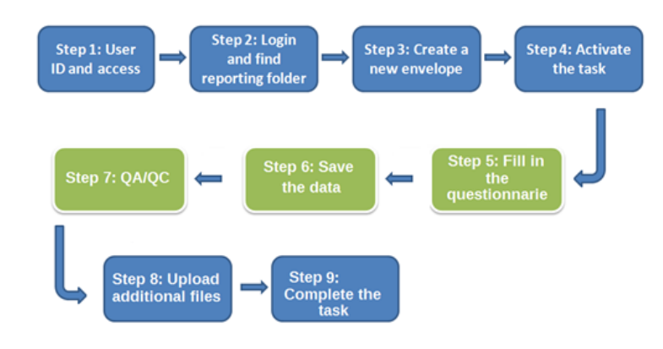
How to report?
Through the ERT provided by EEA: accessible from the relevant CDR folder
E.G.: http://cdr.eionet.europa.eu/at/eu/mercury/activities

Slide 4
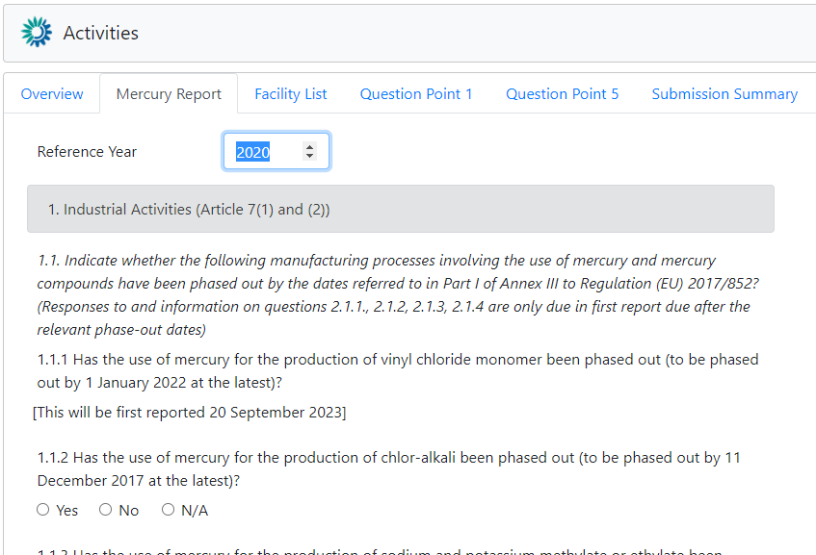
Reporting Activities involving use of Mercury
Deadline: 30th September
Reference year: 2020
What should be reported?
Data for 2019 and 2020
The reference year should not be changed

Slide 5
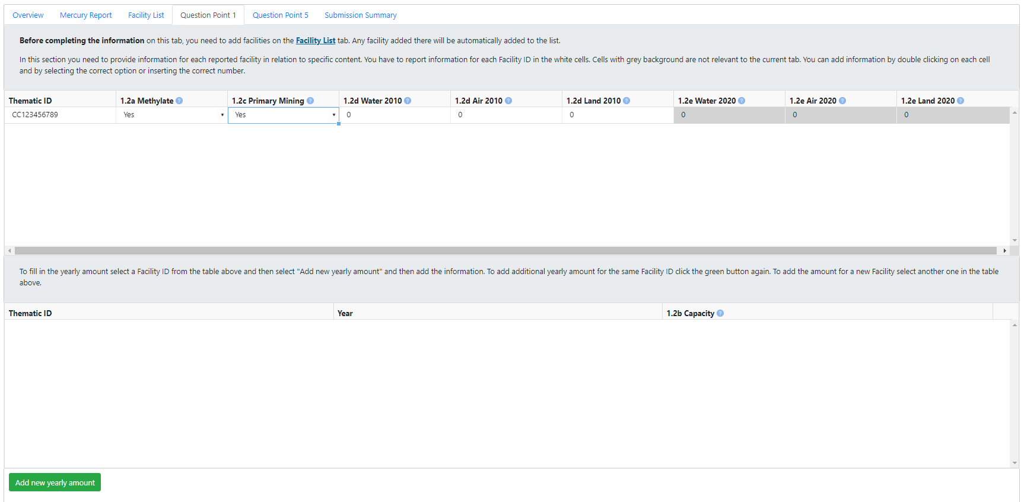
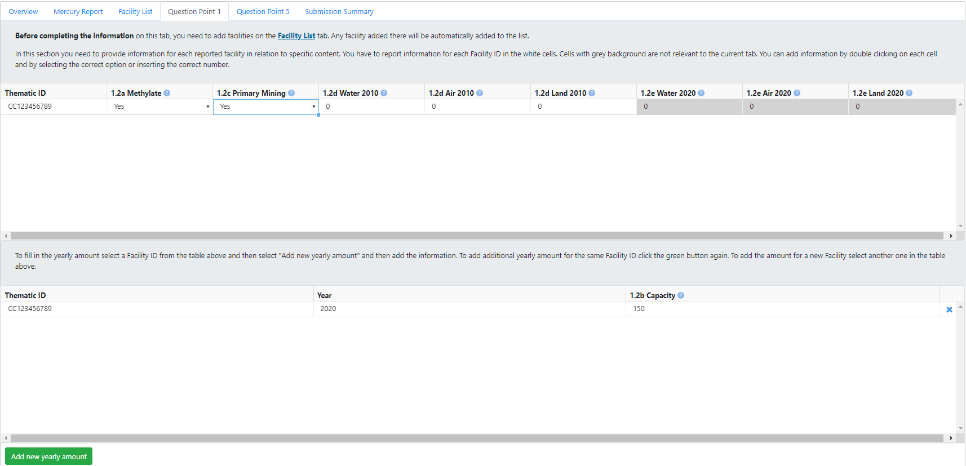
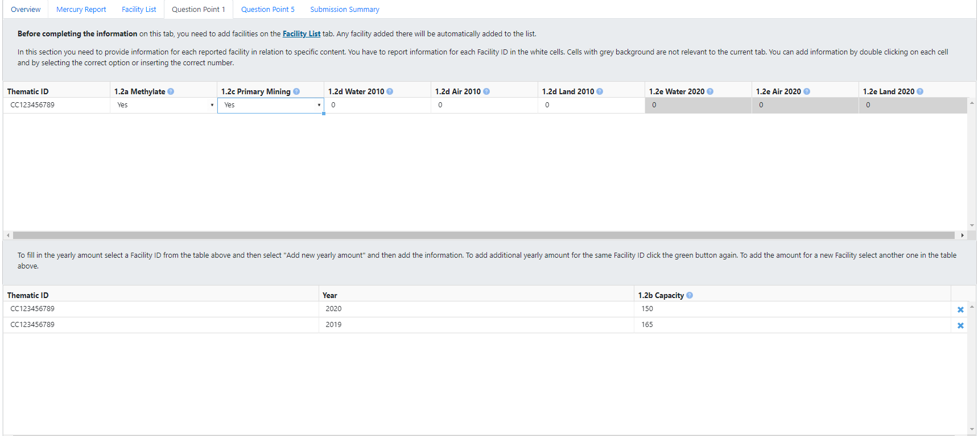
Reporting Activities involving use of Mercury
How to report amount/capacity for additional year?

Slide 6
Additional information
MANUAL FOR REPORTERS is always available at the following link: https://cdr.eionet.europa.eu/help/mercury
MERCURY HELPDESK: mercury.helpdesk@eionet.europa.eu

